Slide 1

S1PR3 Mediates Itch and Pain via Distinct TRP Channel-Dependent Pathways
Rose Z. Hill, Takeshi Morita, Rachel B. Brem, Diana M. Bautista (2018), The Journal of Neuroscience

Slide 2
Why is it relevant?
Itch and Pain are major health problems with few effective treatments
They occur in many other diseases
A detailed understanding of the mechanism would provide new therapeutic targets

Slide 3
Important actors
S1P (Sphingosine-1-Phosphate) main signalling molecule
Has several receptors ➔ different responses
S1P receptor 3 (S1PR3) receptor for itch and pain
TRPA1 and TRPV1 are downstream targets of S1P

Slide 4
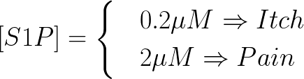
Dosage dependence of S1P
pruriceptors ⬄ Itch (sensitive at low concentrations already)
nociceptors ⬄ Pain

Slide 5
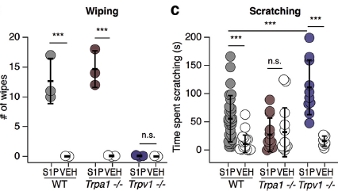
How to test in mice?
number of wipes ➔ Pain
time spent scratching ➔ Itch

Slide 6
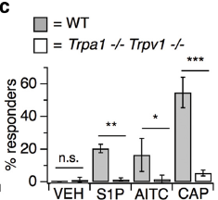
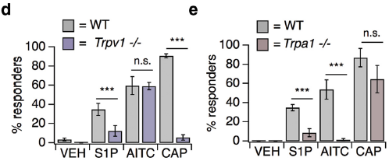
Results
AITC is agonist for TRPA1
CAP is agonist for TRPV1

Slide 7
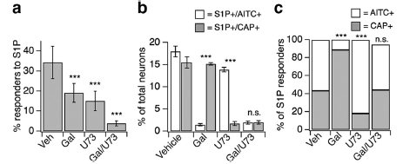
Response with inhibitors
Gallein (Gal) inhibits G-beta/gamma subunit which activates TRPA1
U73 inhibits PLC which activates TRPV1

Slide 8
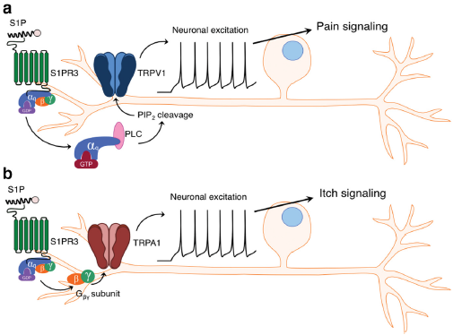
Signalling mechanism

Slide 9
Conclusion
two pathways! (with same beginning though)
different [S1P] induce itch or pain and itch
TRPA1 ➔ Itch
TRPV1 ➔ Pain
S1P/S1PR3 signaling involved in asthma, MS, cancer, skin disorders etc. ➔ further investigation needed!

Slide 10
Thank you for your attention!

Slide 11
Signalling mechanism

Slide 12
Response with inhibitors
Gallein (Gal) inhibits G-beta/gamma subunit which activates TRPA1
U73 inhibits PLC which activates TRPV1

Slide 13
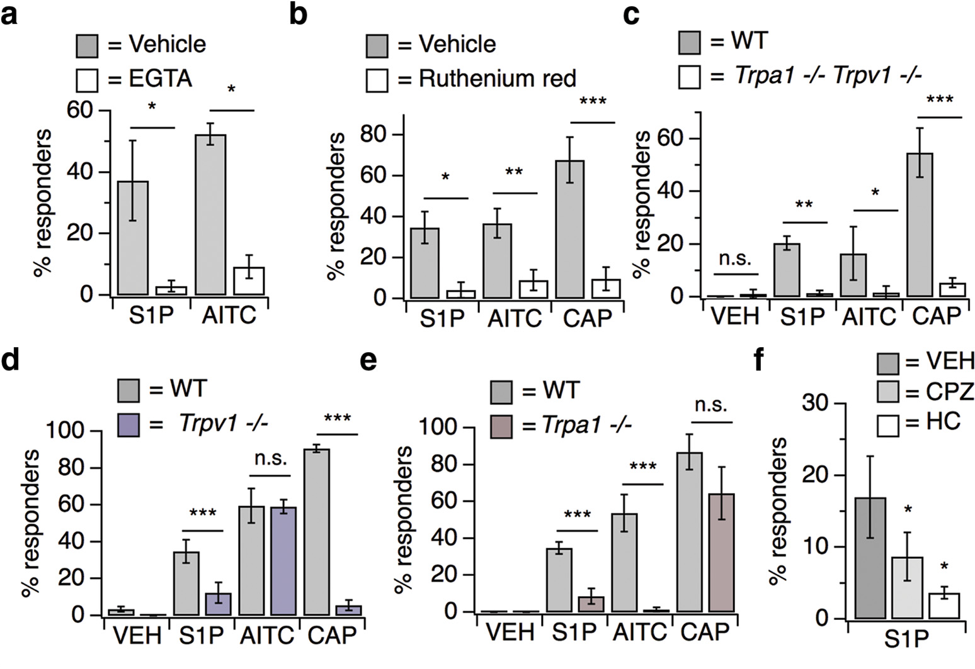
Results
AITC is agonist for TRPA1, CAP is agonist for TRPV1

Slide 14
How to test in mice?
number of wipes ➔ Pain
time spent scratching ➔ Itch

